Slide 1

MACHINE LEARNING
Disusun oleh :
Sindhu Wardhana
Ade Satya Wahan
Aris Budi Santoso
Leonard Yulianus

Slide 2
BASIC MACHINE LEARNING
Setelah mengikuti program pembelajaran, peserta diharapkan dapat:
Standar Kompetensi:
Menerapkan metode dan teknik machine learning tingkat dasar, evaluasi kualitas, dan validasi keakuratan model machine learning.
Kompetensi Dasar:
Menjelaskan konsep dasar machine learning;
Menerapkan pendekatan supervised learning algorithms;
Menerapkan unsupervised learning algorithms;
Menerapkan evaluasi/ pengukuran kinerja model yang telah disusun; dan
Menerapkan optimisasi kinerja model.

Slide 3
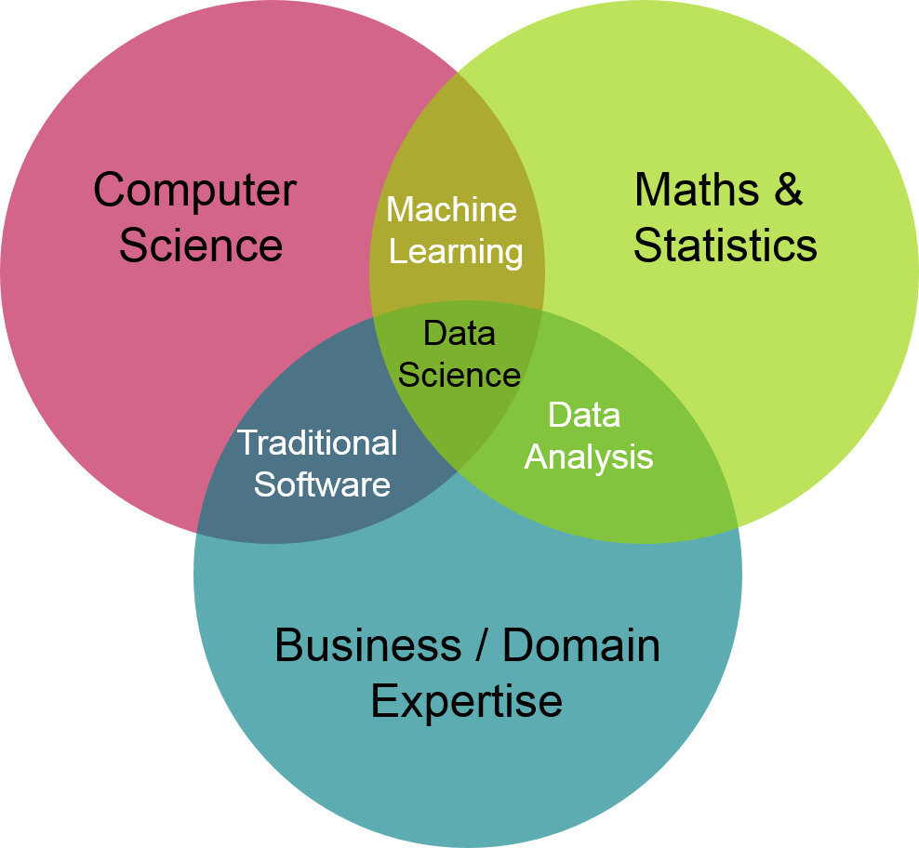

WHAT IS MACHINE LEARNING?
“Ability to learn without being explicitly programmed”
--- Arthur Samuel, 1959
“Learn from experience (E) with respect to some task (T) and some performance measure (P)”
--- Tom Mitchell, 1997
Machine learning is a field of computer science that aims to teach computers how to learn and act without being explicitly programmed
--- https://deepai.org/machine-learning-glossary-and-terms/machine-learning

Slide 4
KEY POINTS OF MACHINE LEARNING
EXPERIENCE (E)
PERFORMANCE (P)
TASK (T)
Machine learning untuk memprediksi cuaca
Prediksi cuaca
data riwayat indikator kecepatan angin, kelembaban udara, suhu, pembentukan awan, tingkat curah hujan pada lokasi tertentu
persentase kondisi cuaca yang diprediksi dengan tepat (akurasi)

Slide 5
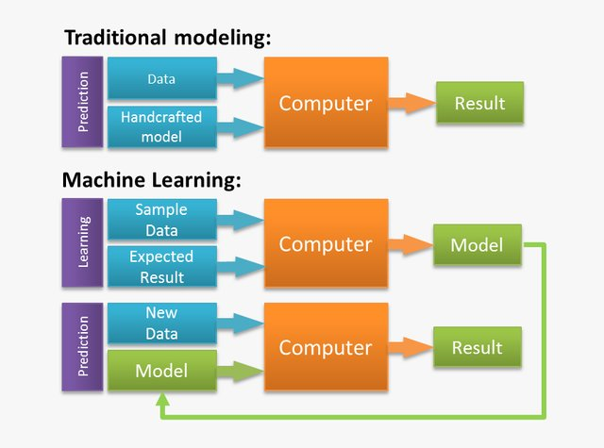


TRADITIONAL PROGRAMMING VS MACHINE LEARNING
Orang menulis rule dalam bentuk kode aplikasi
Model (komputer) dilatih menggunakan data
contoh ril sederhana : klik di sini
Mehra, Sidharth & Hasanuzzaman, Mohammed. (2020). Detection of Offensive Language in Social Media Posts

Slide 6

BUT WHY MACHINE LEARNING?
You wouldn’t want be this guy
No Human Experience Yet
Can’t explain the experience
Many solutions adaptation
Situation changes
Large amount of Data
Human are too expensive
Checking all data by eyes and hands

Slide 7
EXERCISE – T / E / P / NONE
P
Jumlah makanan yang dengan benar diklasiﬁkasikan sebagai seafood
N
Mengubah daftar menu menjadi matrix/angka
Aplikasi Machine Learning di restoran seafood
T
Mengklasiﬁkasikan label makanan sebagai seafood atau bukan seafood
N
Download daftar makanan dari internet
E
Dataset berisi makanan yang telah dilabeli seafood dan bukan seafood

Slide 8
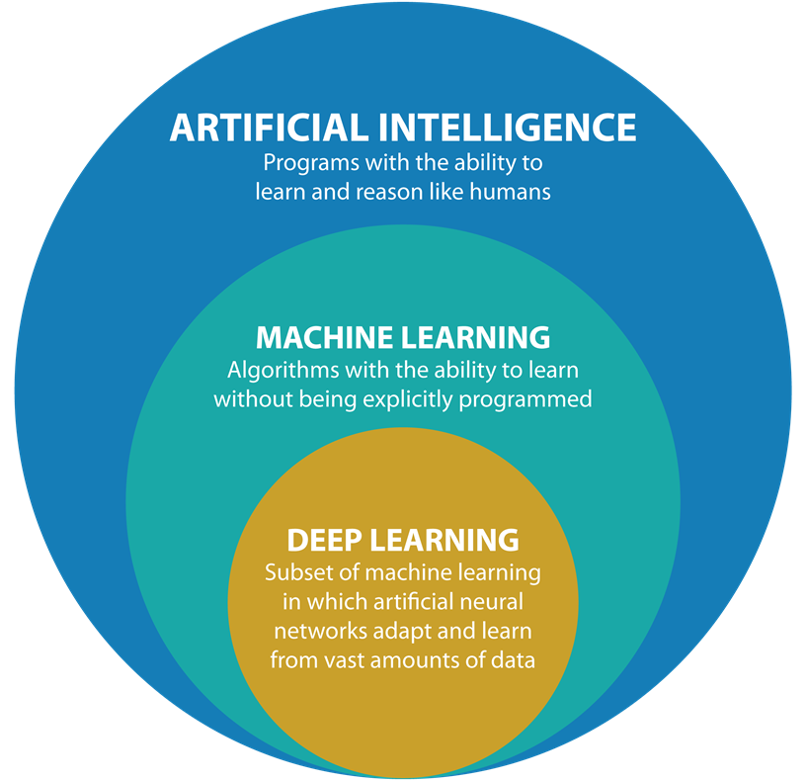
JARGONS ??

Slide 9
MACHINE LEARNING TYPES
Supervised
Menggunakan dataset memiliki label (E) untuk memprediksi varible target (T)
Unsupervised
Menggunakan dataset tanpa label (E) untuk melihat/mempelajari pola (T)
Semi-supervised
Reinforced Learning
Menggunakan data dg label dan tanpa label (E) untuk memprediksi / mempelajari pola (T)
Menggunakan data hasil simulasi secara iterative (E) untuk mencapai tujuan (T) (memperbesar reward / mengurangi error)

Slide 10

SUPERVISED LEARNING

Slide 11
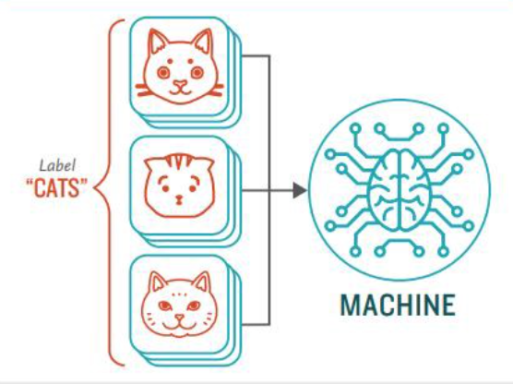
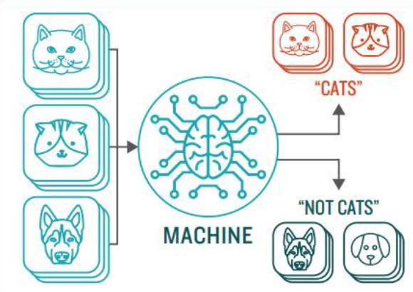
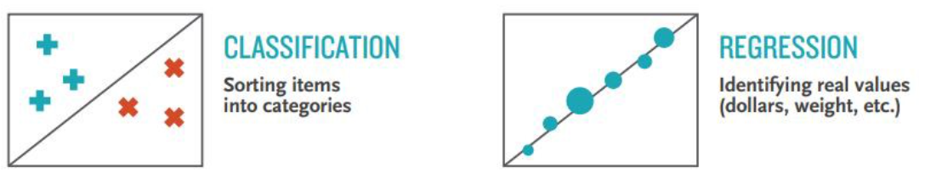

Supervised Learning
STEP 2: Predicting
STEP 1: Training
Different Types Based on Target Variable
Let’s go to math…

Slide 12
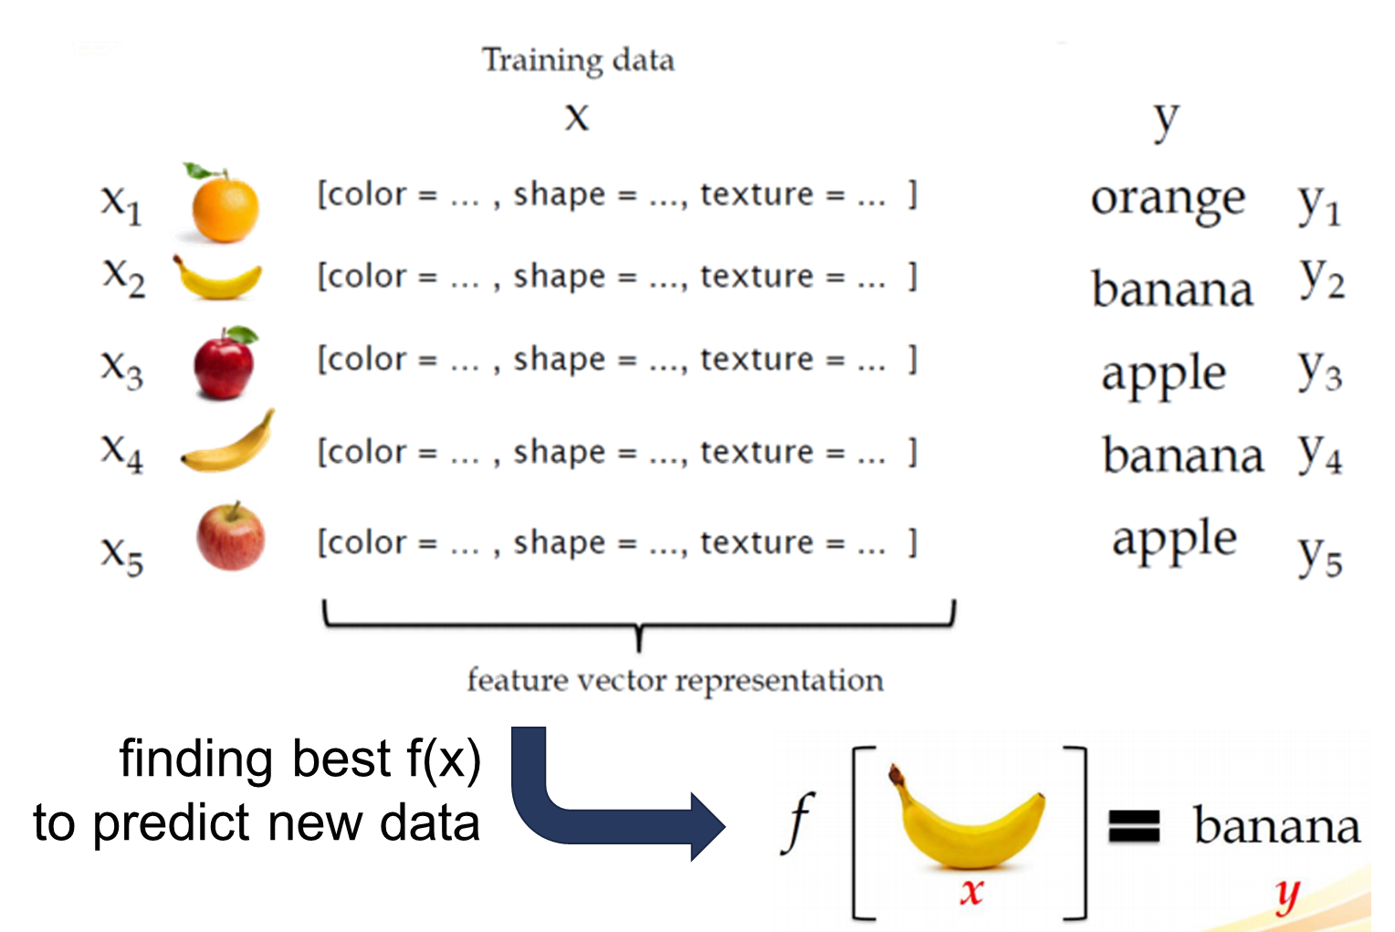
Simple Math Notation on Training Step

Slide 13
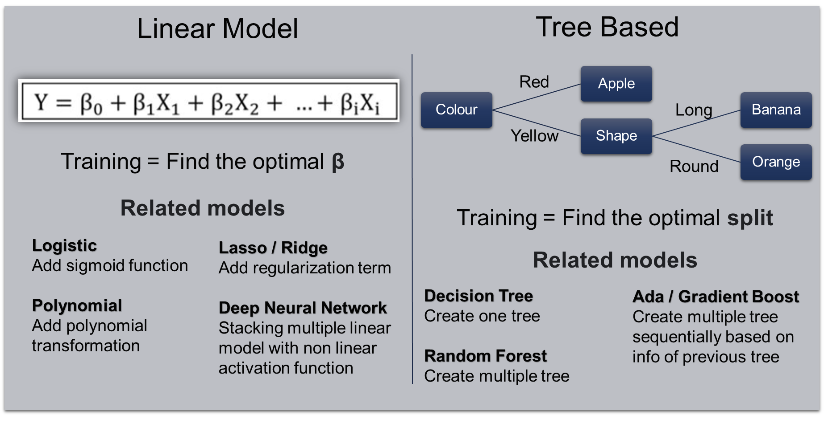
Some Supervised Learning Models

Slide 14
Let’s Coba
Buka notebook di google colab

Slide 15

EVALUATION

Slide 16

Model Evaluations
But, how good is it’s performance?
Ok, so I have a machine learning model now
Is it the best model?

Slide 17
Step to effectively evaluate
Choose the correct performance metric
Pick a preferred evaluation approach/method
Analyse the result

Slide 18
Supervised Model Performance Metrics
Classification
Confussion Matrix
Area Under the Curve (AUC)
Regression
Root Mean Squared Error (RMSE) / MSE
Mean Squared Error (MAE)
Accuracy
Precision
Recall
F1-Score
MAPE
Adj R² / R²
Other:

Slide 19
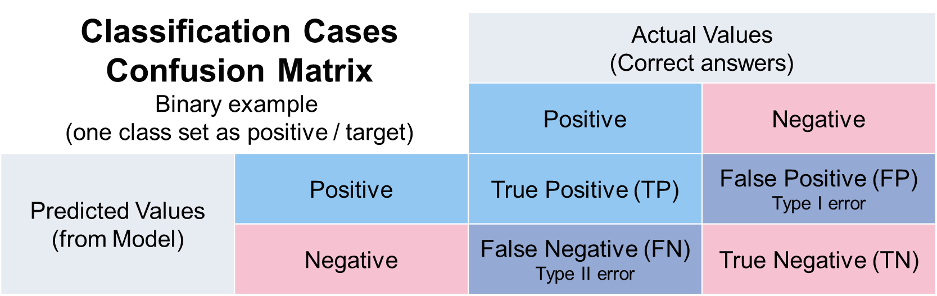
Classification Model Evaluations
Accuracy:
percentage of test data that are correctly classified
Accuracy = (TP + TN)/All
Error rate: 1 – accuracy, or
Error rate = (FP + FN)/All

Slide 20
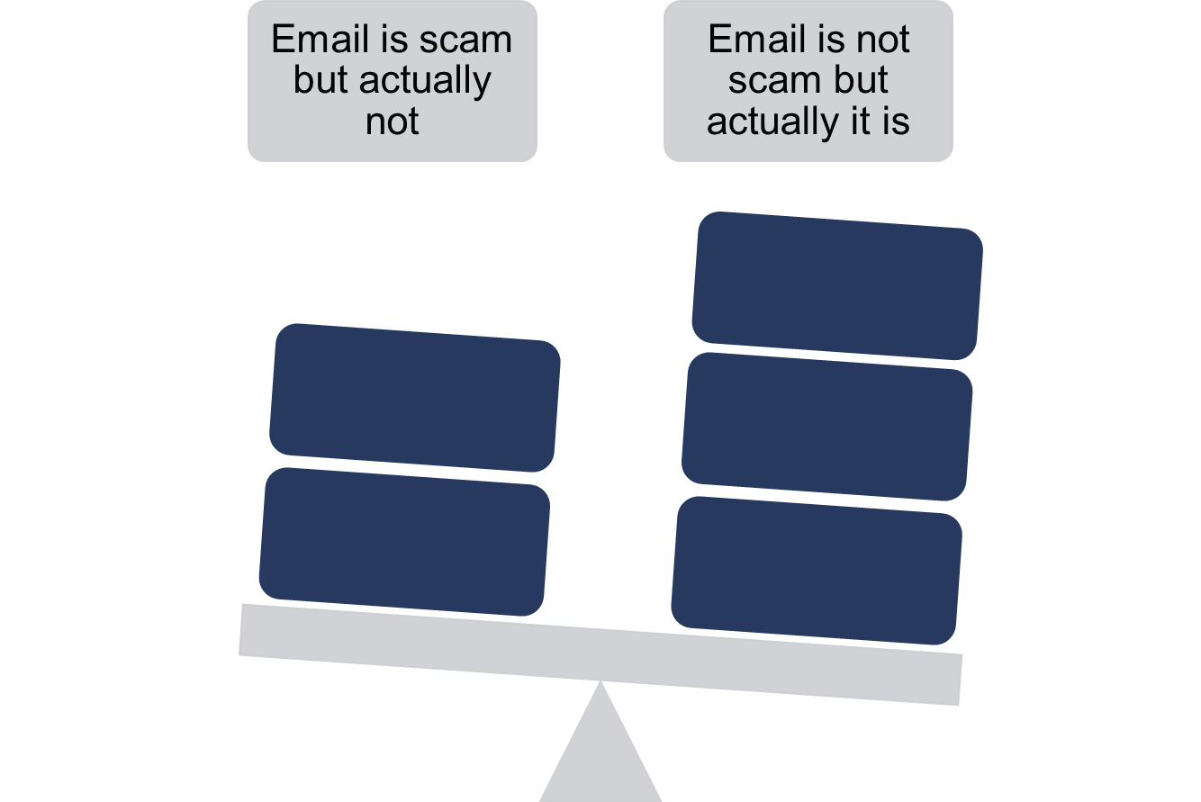
Classification Model Evaluations
Accuracy will have an issue when is used on imbalance target variable
Imbalance = one class may be rare, e.g., fraud, or Scam
So, we need to consider the prediction false cost and use other metric
Let’s discuss:
in a case of predicting scam,
Which false is more costly?

Slide 21

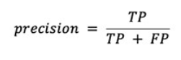
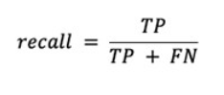
Classification Model Evaluations
Precision = when the costs of false positives are high
Recall = when the cost of false negatives is high
F1 / F-score is an overall measure of a model’s accuracy that combines precision and recall

Slide 22
Regression Model Evaluations
Mean Squared Error (MSE)
Error (true – prediction), squared, get average, rooted if RMSE
MAE
Error (true – prediction), turn to positive value (absolute), get average
Caveat
Value can be from 0 to ∞
Minimized is better
Minimal means predictions are near true values

Slide 23
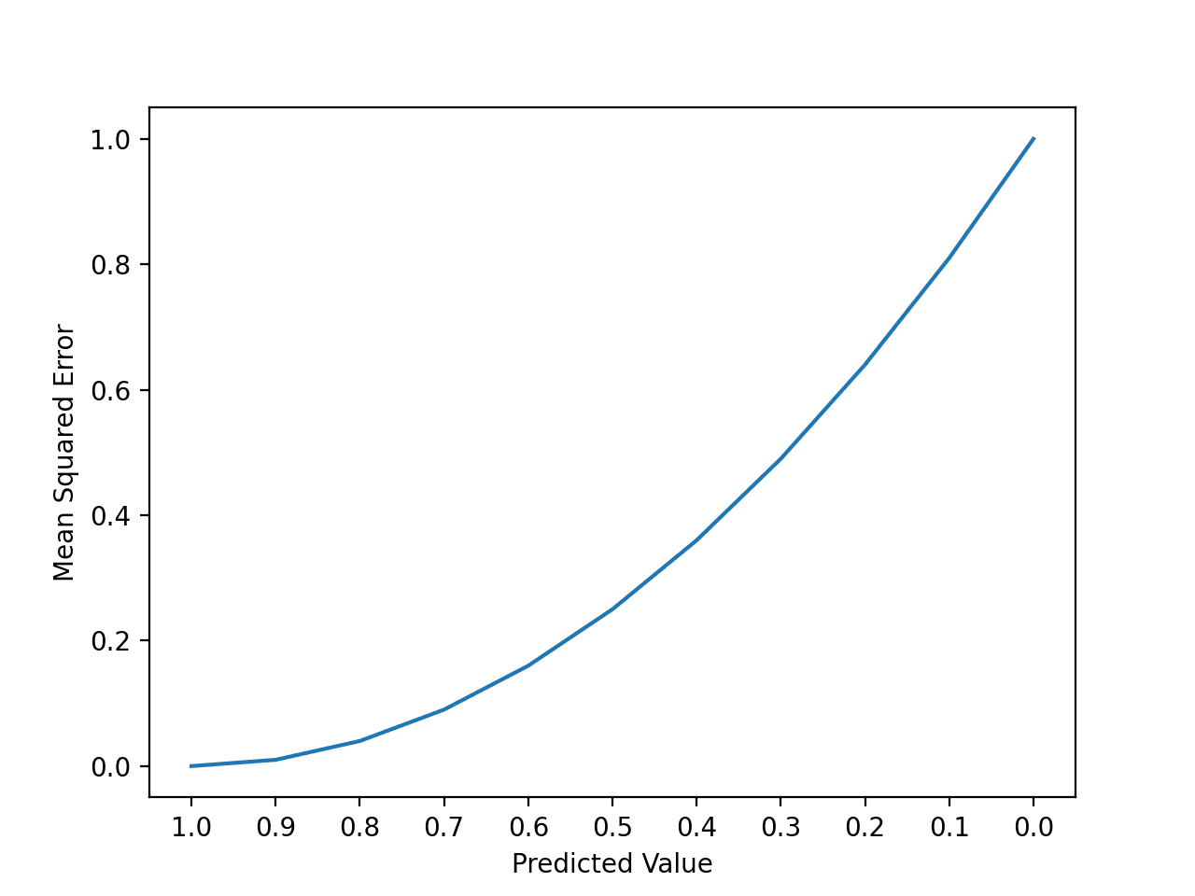
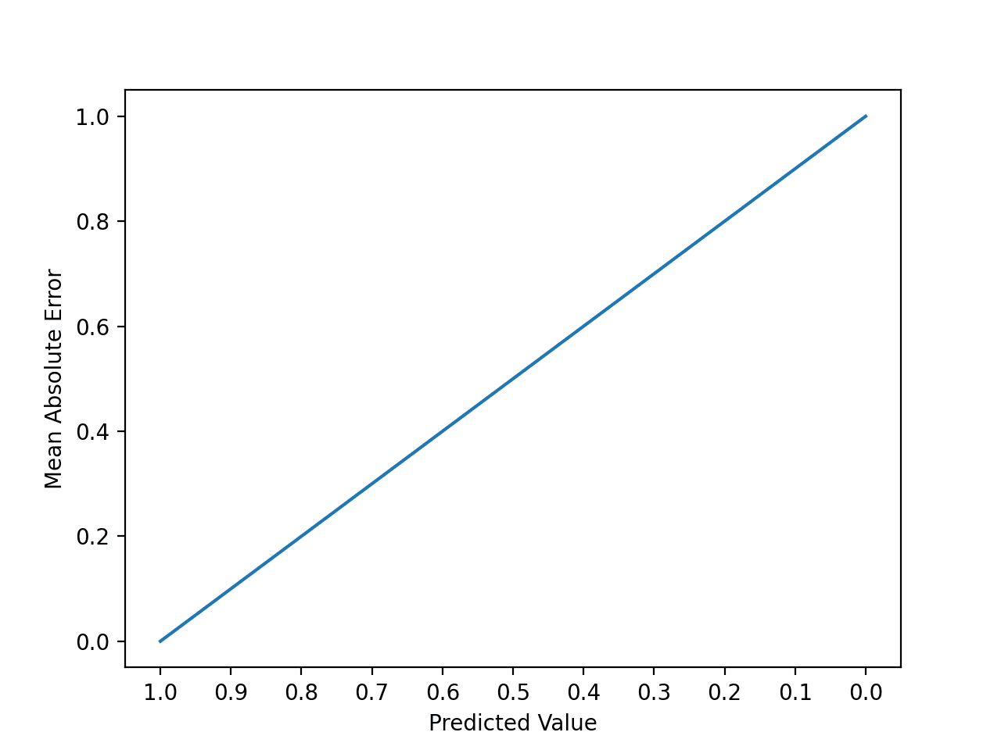
Regression Model Evaluations
Mean Squared Error (MSE)
Mean Absolute Error (MAE)
Bigger score on bigger error
Score are on different value scale (squared)
Use RMSE to turn it back to original value
Scores are linear for every error
Score are on a same value range
Both don’t show indication on how good is the model
But they are useful to compare model
The best practice is to make a benchmark score
Other metric:
R² / Adj R²
MAPE

Slide 24
Let’s Coba
Buka notebook di google colab

Slide 25
Model Evaluations
Ok, I’ve picked the best machine learning model
But, will it perform as good as it’s training performance

Slide 26
Evaluation Method
Differentiate data for train and evaluate models
Measure the model performance when used on unseen data
We need Evaluation Method
Hold Out
Bootstrap CV
K - Fold CV

Slide 27
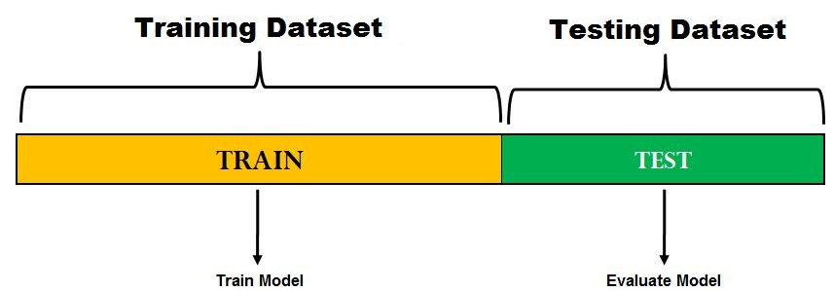
Hold Out Method (Splitting)
No golden rules for splitting ratio (75:25, 80:20, 90:10)
Important to make sure test data represents unseen new data
Good approach if we have limited data
Only gives one performance score
RapidMiner:
Splitting Validation Widget

Slide 28
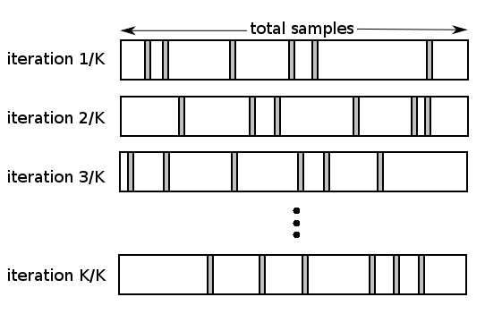
Bootstrapping Cross Validation
Use sampling on creating Training and Testing data
(random / stratified)
Repeating K times and final score is the average of all performance score
Out-of-Bag problem
RapidMiner:
Bootstrap Validation Widget

Slide 29
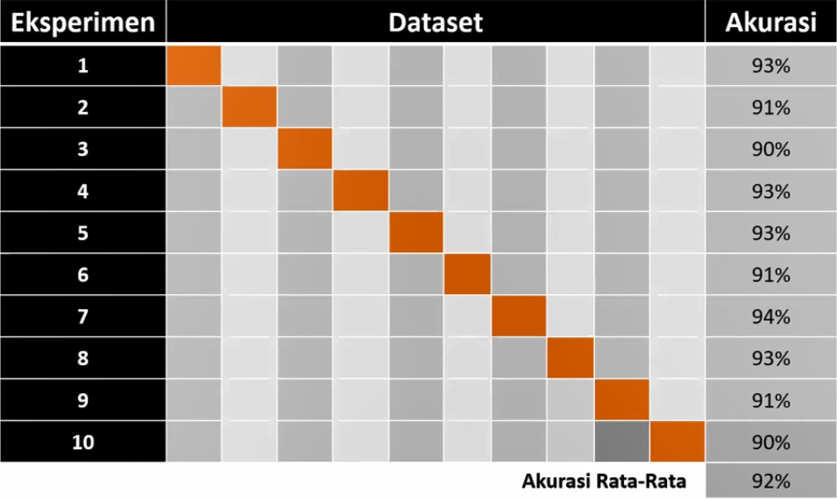
K-Fold Cross Validation
Need more time to finish training process
RapidMiner:
Cross Validation Widget

Slide 30
Let’s Coba
Buka notebook di google colab

Slide 31

PERFORMANCE TUNING

Slide 32
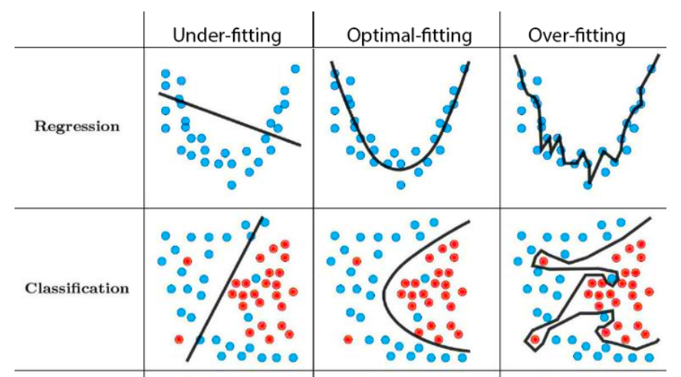
Model Tuning
Maximizing model’s performance but with an acceptable generalization level

Slide 33
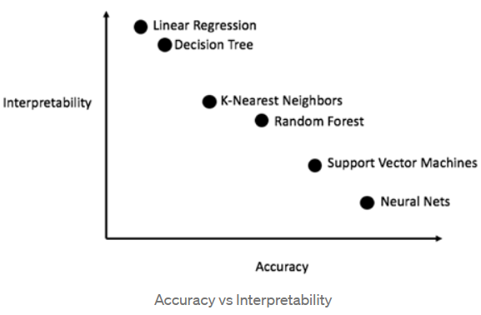
Model Complexity
Model complexity can be defined by:
How many parameters learned by the model
How difficult for human to explain the model
How well the model learned training data
Notes:
Model Complexity dapat diartikan sebagai seberapa banyak parameter yang harus dipelajari oleh model untuk dapat memprediksi target. Jumlah parameter ini tergantung pada seberapa kompleks algoritma yang digunakan dan juga seberapa banyak feature yang ada pada data training.
Model complexity juga berpengaruh terhadap interpretability model. Model-model yang kompleks dapat memiliki performa yang baik namun akan sulit jika ingin menjelaskan apa yang dilakukan didalam model untuk dapat menghasilkan prediksi.
Model yang kompleks dapat menangkap lebih banyak informasi pada data training termasuk noise yang ada pada data sehingga cenderung menjadi overfit terhadap data training tersebut. Sementara model yang sederhana kurang mampu menangkap pola pada data train sehingga terkadang menjadi underfit terhadap data training.

Slide 34
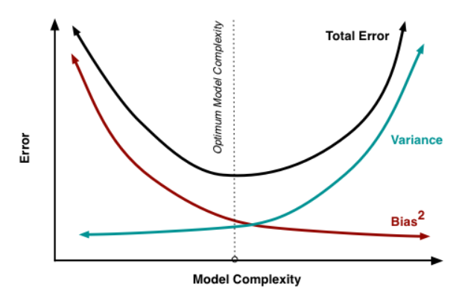
Bias Variance Trade-off
Bias is the difference between the average predicted results of our model and the actual value.
Variance is the variability of our model's prediction of the data points that show the distribution of the data.

Slide 35
How to Tune
Change ML Algo
Feature Engineering
Tuning Hyperparameter
Ensemble Approach
Use more/less complex model
Add new rows (introduce more data to lower variance)
Add new / reduce columns (change complexity)
GridSearchCV
RandomizedSearchCV
Combine uncorrelated models to make an unified model

Slide 36
ML Algorithm Alternatives

Slide 37
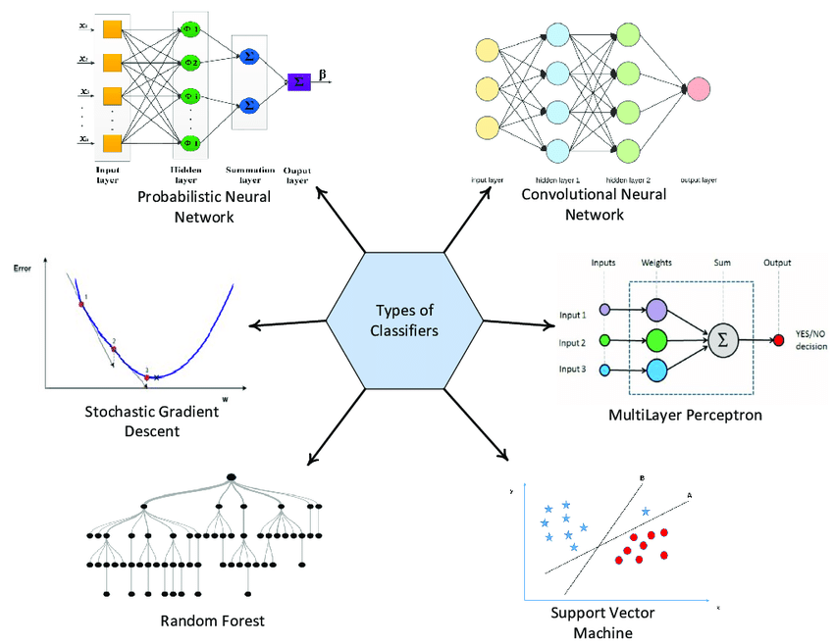
SUPERVISED LEARNING ALGORITHMS
K Nearest Neighbor
Naïve Bayes
Support Vector Machine
Logistic Regression
Decision Tree
Bagging : Random Forest
Boosting : AdaBoost, XGBoost, LGBM
Stacking: Voting, Stacking
Linear Model Family
Artificial Neural Network

Slide 38
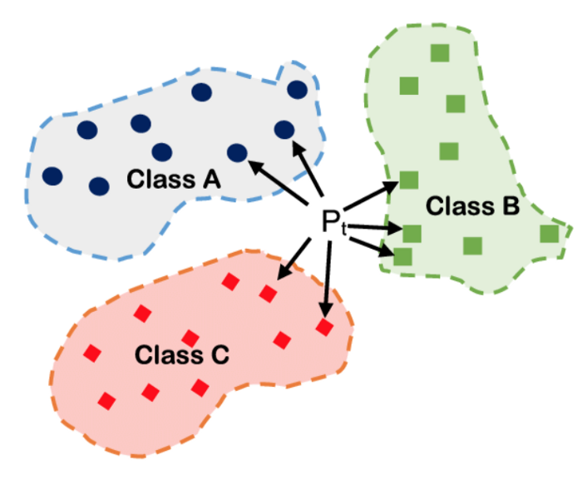
K NEAREST NEIGHBOR (K-NN)
Klasifikasi berdasarkan jarak antara titik (Eucleadean distance)
Menggunakan sejumlah titik terdekat (k) sebagai penentu
Classification : class mode of neighbours
Regression : mean of neighbour’s values

Slide 39
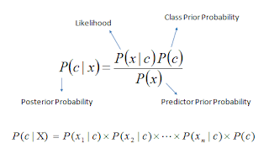
NAÏVE BAYES ALGORITHMS
Classification berdasarkan conditional probability, Bayes Theorem
Asumsi bahwa setiap predictor tidak saling terkait
c = Kelas/ kategori yang menjadi target prediksi
X = Data yang akan diprediksi kelasnya
x1, x2, x3, …. xn = Feature dari data X yang diprediksi kelasnya
Only Classification

Slide 40
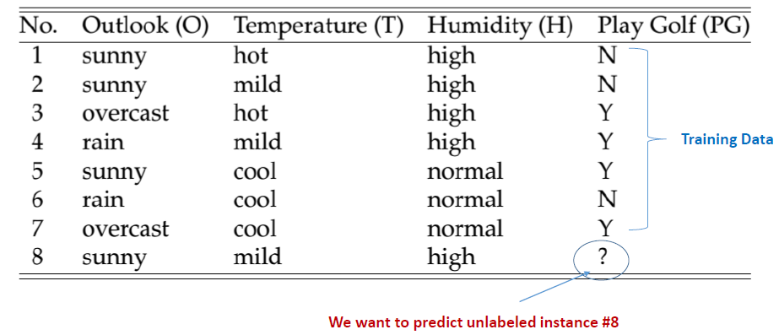
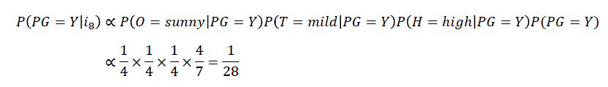
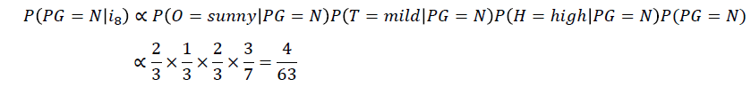
NAÏVE BAYESIAN ALGORITHMS
P(PG=Y|i8) > P(PN=Y|i8)
Sehinga kemungkinan Play Golf dengan kondisi i8 adalah NO

Slide 41
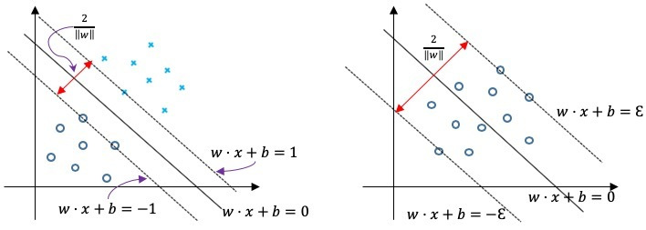
SUPPORT VECTOR MACHINE
Menemukan hyperplane yang optimal untuk membagi data ke dalam 2 atau lebih kelas
Hyperplane dapat linear maupun non linear
Kernel Trick
Classification : SVC
Regression : SVR

Slide 42
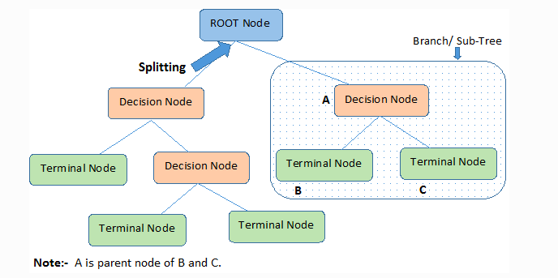
DECISSION TREE
Classification menggunakan alur berupa pohon keputusan
Menentukan root node
Menghitung Entropy dan Information Gain secara iterasi
Memilih atribut dengan Entropy paling rendah dan Information Gain paling tinggi
Classification : class mode of predicted nodes
Regression : mean of predicted nodes

Slide 43
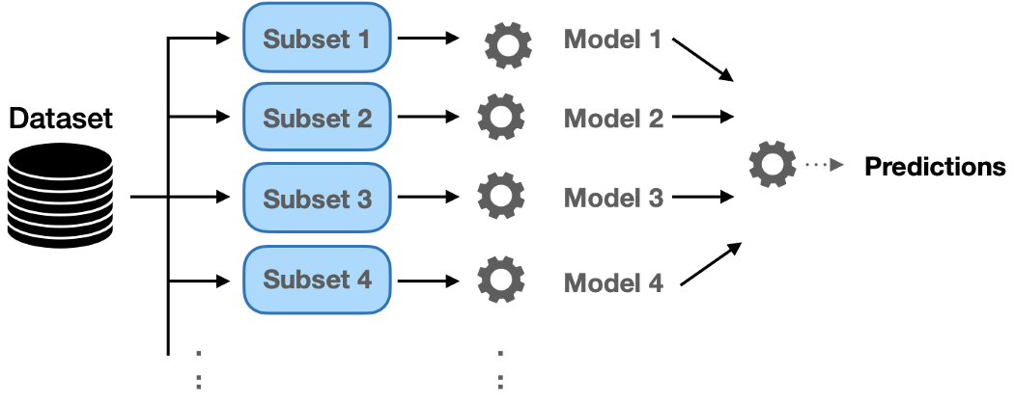
ENSEMBLE - BAGGING
Classification : RandomForest (mode)
Regression : RandomForest (mean)

Slide 44
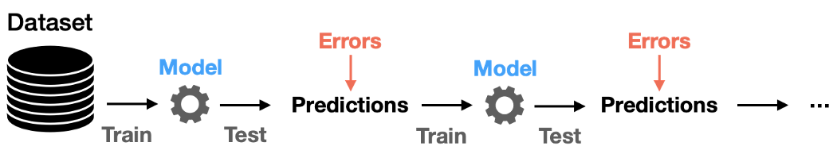
ENSEMBLE - BOOSTING
Classification : AdaBoost, XGB (mode)
Regression : AdaBoost, XGB (mean)

Slide 45
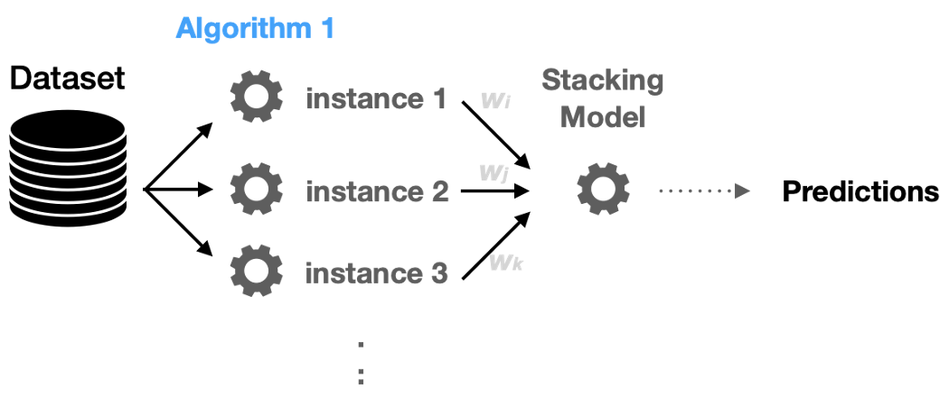
ENSEMBLE - STACKING
Classification : Any classification models
Regression : Any regression models

Slide 46
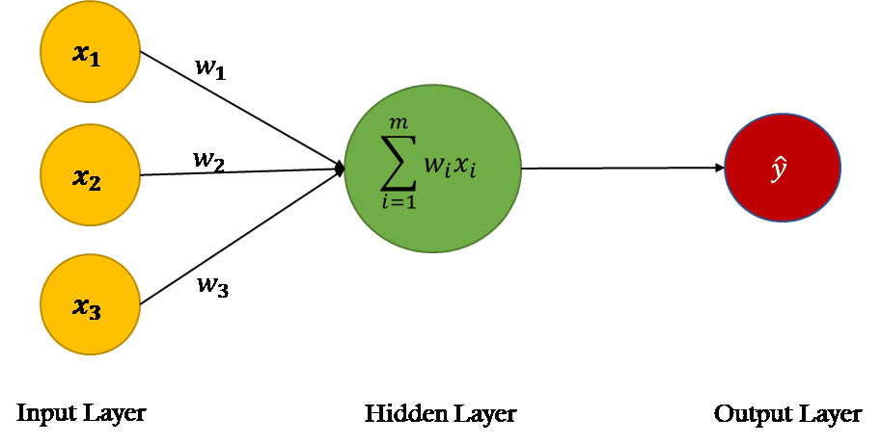
Linear Model Family
Linear
Logistic
Polynomial
SGD
Perceptron
Lasso |w|
Ridge w²
Elastic Net
Activation function
Sigmoid
Tanh
Relu
Softmax
etc
https://towardsdatascience.com/power-of-a-single-neuron-perceptron-c418ba445095
Classification : Softmax on output layer
Regression : no actiovation on output layer

Slide 47
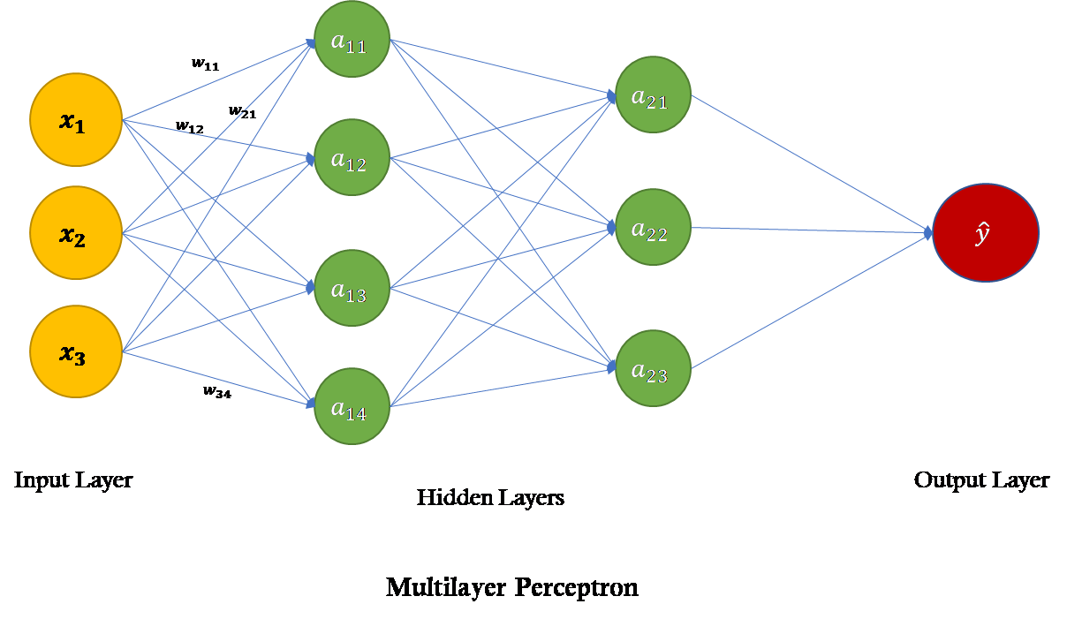
ARTIFICIAL NEURAL NETWORK
Multilayer Perceptron (MLP)
Neural Network
https://towardsdatascience.com/power-of-a-single-neuron-perceptron-c418ba445095

Slide 48
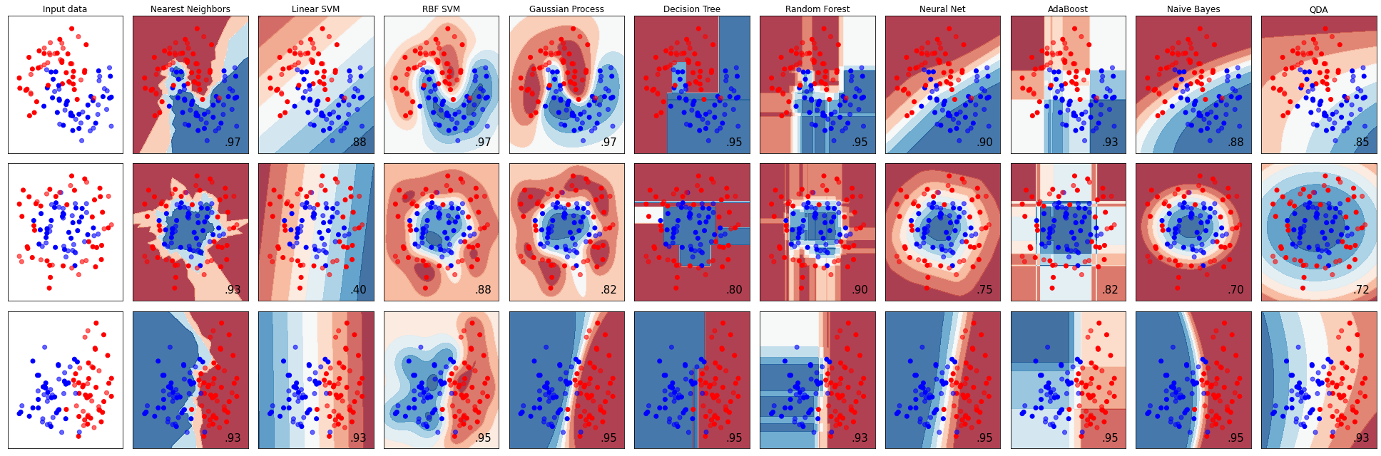
CLASSIFICATION ALGORITHMS
https://scikit-learn.org/stable/auto_examples/classification/plot_classifier_comparison.html

Slide 49
Let’s Coba
Buka notebook di google colab

Slide 50

TERIMA KASIH

